Slide 1
A Cloud solution for telemetry data
AgI
(Named after Silver Iodide that is used to seed clouds)

Slide 2
What is telemetry?
A collection of reads of a sensor over time
Regular reads or irregular a.k.a. events
{ “point”: 180, “epoch”: 1234567, value: 14.6}
Where/What, When, , Read
Examples: Temperature, Wind direction & speed, Alerts.

Slide 3
How is it used?
Monitor, control (SCADA)
Alerts, troubleshooting, response
Operational efficiency: KPI, decision support
Predictive maintenance
Settlement

Slide 4
Data Model
Equipment Hierarchy (symmetrical)
Site
Array
Core
Core
Array
Core
Node
Node
Node
Node
Node
Node
Node
Node
Node
Core
Node
Node
Node
Site
External Temp
Wind Direction
Weather
Alert
Wind Speed
Unauthorized Entry Alert
Node
Charge Level
Charge Rate (+/-)
Temperature
Braker State
Array
Power Supply output
A/C
State
Unit temp.
Alerts
Reads

Slide 5
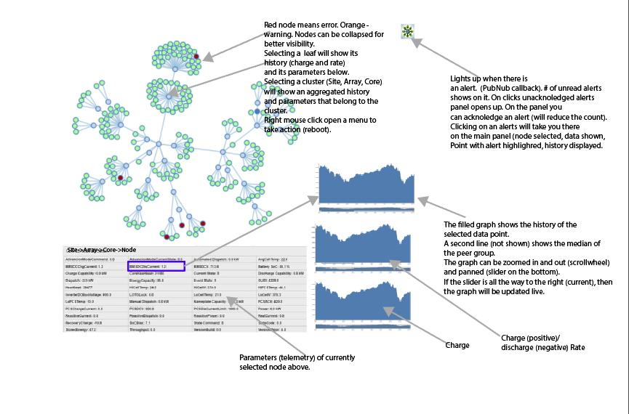

Slide 6
Operations on Data Model
Retrieve (Initialize and brushing)
Summarize (to support zooming out/in)
Median (to highlight deviation from peers)
Subscribe (update live feed)

Slide 7
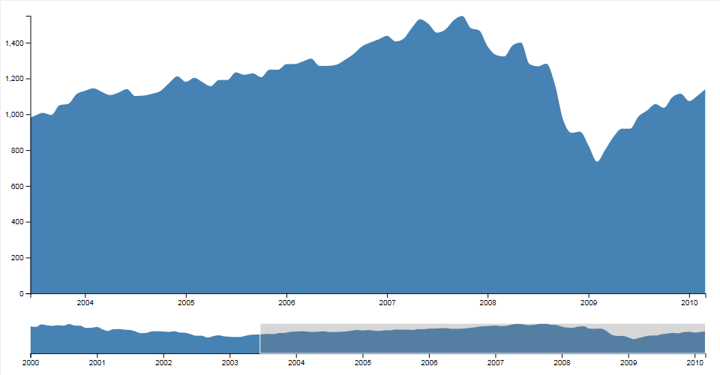
Visualizations
Value Brush and zoom

Slide 8
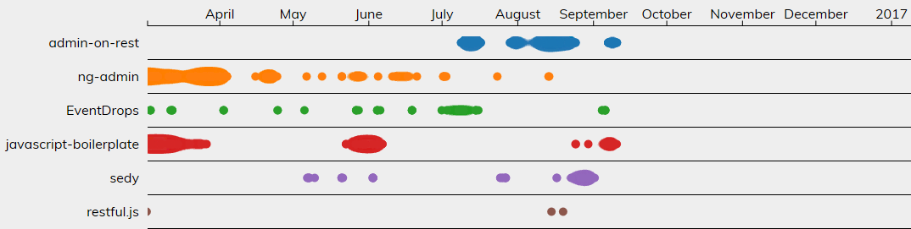
Event brush and Zoom

Slide 9
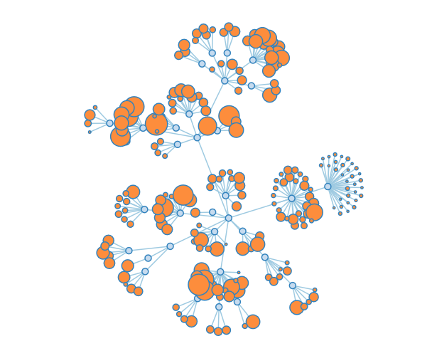
Historical depth equipment Hierarchy

Slide 10
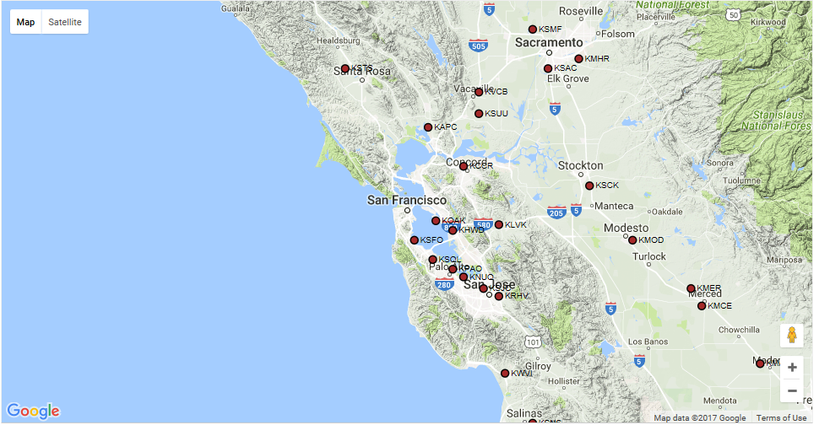
Smooth server supported brush and zoom

Slide 11
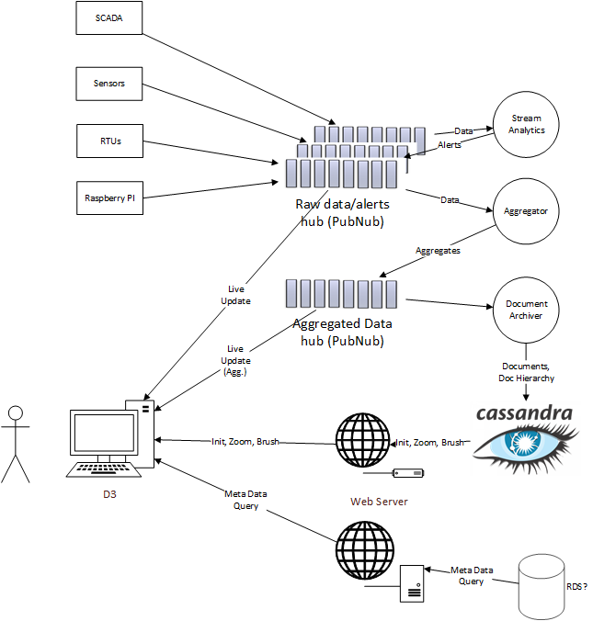
Architecture

Slide 12
Work to be done
Hookup SCADA to PubNub (Python to SQL Server)
Seed historical SCADA data in Cassandra (via RDS? Via PubNub?)
Hookup Raspberry PI to PubNub (???)
PubNub? (1M messages/month)
Design meta-data repository, Schema and API
Aggregator worker (pubNub Block? Other serverless technology?)
Cassandra? (another NoSQL?)
Design hierarchical data model (and JSON structure) for streams
Visualizations (W209? Simple prototype to reduce dependency and avoid blockage?)

